Slide 1
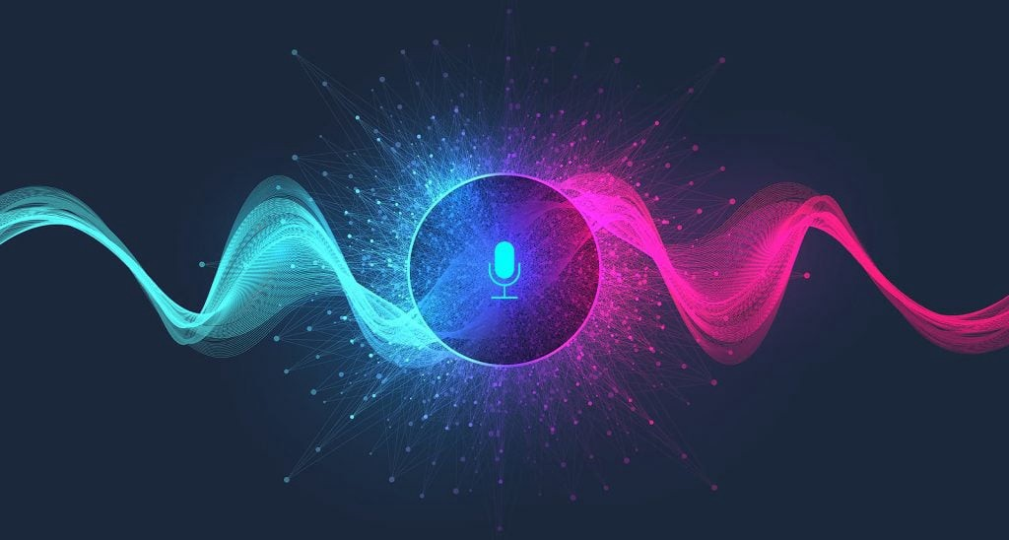
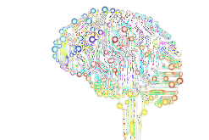
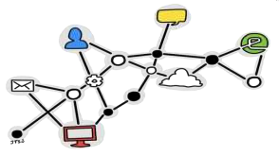
Voice Assistance Model
Presented by - Jatin Sharma
REG. NO.: RA2132241030008
Group No. - 6
Under The Supervision of - Dr Rupak Sharma Sir

Slide 2
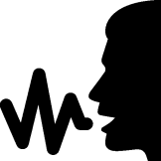
Introduction
A Voice Assistant is a piece of software that communicates to the user audibly, and responds to spoken commands. It's technology like Google Home, Siri and Alexa that can be used to literally talk to a computer, a smartphone, or another device. It can perform tasks or services for an individual based on commands or questions. Users can ask their assistants questions, media playback via voice, and manage other basic tasks such as news, jocks, facts and search information on Wikipedia and google with verbal commands.
In this Project physically disable person or the person having less knowledge about Technology or how to access the devices like Laptop or mobile, can easily access the device with their voice or speech command. This application includes the functions and services such as: location services, music player service, checking weather, Google search, Wikipedia search, Fun facts.

Slide 3






.
The working of Virtual Assistant uses following principles:
1.Natural Language Processing.
To Understand user’s speech input.
2.Automatic Speech Recognition.
To understand command according to user’s input.
3.Artificial Intelligence.
To learn things from user and to store all information about behavior and relations of user.
4.Inter Process Communication.
To get important information from other software applications.

Slide 4
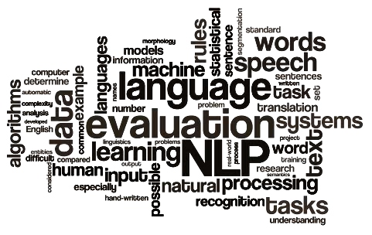
.
Hardware And Software Requirements
Platform-
Windows 8.1 or above
Hardware Requirements-
Minimun-i3 processor,4GB RAM,1GB Space at least
Recommeneded-i5 processor,8 GB RAM,10 GB ROM

Slide 5



Any Virtual Assistant basically consists of three layers.
Speech to text
Text Analysing
Interpret commands

Slide 6



1. Speech to text:
A Piece of software used that converts audio to text.
It doesn’t understand just anything you might say.
Text Analysing:
Converted text is just letters for computer.
A piece of software converts text to something that is understandable for computer.
Computer understands the command, so Virtual Assistant like siri convert this text to computer command.

Slide 7
VPAs maps the words to functions and parameters to create a command that
computer can understand.
Example of Reminder.
Interpret commands:
In this layer, that mapped computer command, go to server through internet.
Simultaneously, your speech evaluated locally.
A local recognizer communicate with server to judge whether command will be best handle locally or not.
Example:
Play Music , Google search…

Slide 8



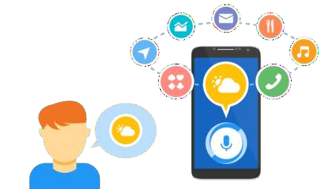
These applications make small and smart hand-held devices to combine
multiple features.
1.They allow you to export and import data.
2.Store various information.
3. Search on google
4.Recognizes voice commands.
5.Controls various applications of device.
6.Provides services regarding your location.
7.Helps to Play song
8.Reminds you important things on accurate situations or location. (Geofencing)

Slide 9
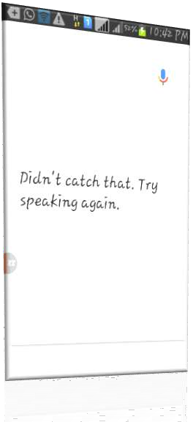
Disadvantages
Listening problem.
VPA get problem to process wrong pronounced words and miscellaneous words.
Silent mode support.
VPA gives response in voice output
thus it doesn’t work properly in silent mode.
Navigation languages.
Most of VPAs can understand only English language.
Internet access.
VPA needs internet connection to give desired output.

Slide 10
Modules used
Speech Recognition
PYTTSX3(Python text to Speech):
Selenium
Random
RandFact
Pyjokes
Pywhatkit
Beautiful Soup

Slide 11
Future Scope
We currently live in a world where voice assistants and AI have by-passed science fiction and have become a basic, even a necessary part of everyday life.
It will helpful for blind people (Physically Disabled people )
It will help us to do multiple work at a same time
It will save Time
It will make life easy
It can save life too , if we attach it to with smart band or medical equipment

Slide 12





